Slide 1
Java EE Training Course
Common application architecture
Notes:
ATS Application Programming: Java Programming
Brown Bag: XML
© Accenture 2005 All Rights Reserved
Course Code #Z16325

Slide 2
Agenda
Application layering
Package structure
Coding to interface
Configuration in property files
Notes:
ATS Application Programming: Java Programming
Brown Bag: XML
© Accenture 2005 All Rights Reserved
Course Code #Z16325

Slide 3
Application layering
JSP/HTML/JS
(*.jsp *.html)
Presentation layer (PL)
DTO
ajax
DTO
Controller
(Servlet)
Rest Controller
(Regular Spring Beans)
WS bean
(Regular Spring Beans)
Front layer (FL) - calls BL, converts data (entity<->DTO), controls JSP to represent
entity or
raw parameters
Business layer
(Regular Spring Beans)
Business layer (BL) - implements application business logic
entities, data
Data layer
(DAO, Spring Data)
Data access layer (DAL) - provides simplified access to data stored in persistent storage of some kind.
SQL
raw data
DB
Notes:
ATS Application Programming: Java Programming
Brown Bag: XML
© Accenture 2005 All Rights Reserved
Course Code #Z16325

Slide 4
Application layering (example)
Login.jsp
UserMain.jsp
Login JSP page. Calls servlet POST on form submit
login, password
error
redirect
Login Servlet class. Extracts login parameters, calls BL. Analyzes BL results, redirects to login or main page
Login.doPost
(Servlet)
login, password
error
String UserBusinessServiceImpl.login
(String user, String password)
(Regular Spring Beans)
User service class, login method – gets user by login from DAO, checks if user exists, checks password, returns result.
User login
User entity
UserDAO.getUserByLogin(String user)
(DAO, Spring Data)
User DAO class – returns user by login
SQL
raw data
DB
Notes:
ATS Application Programming: Java Programming
Brown Bag: XML
© Accenture 2005 All Rights Reserved
Course Code #Z16325

Slide 5
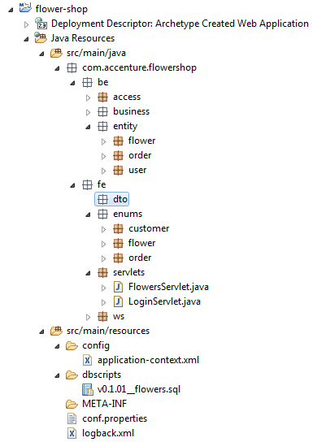
Application package structure
com.accenture.flowershop – unique application base package
be package – back end components (entity, business services, access services)
fe package – front end components (DTOs, servlets, webservices)
*Enums are usually not duplicated in different application layers
Each package should contain functional packages (user, order, etc.)
Notes:
ATS Application Programming: Java Programming
Brown Bag: XML
© Accenture 2005 All Rights Reserved
Course Code #Z16325

Slide 6
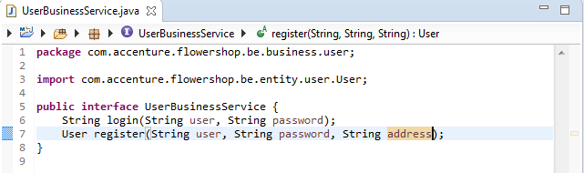
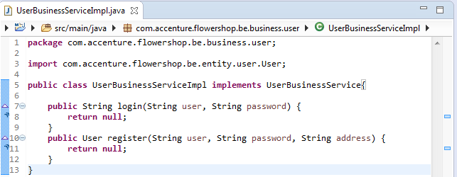
Coding to interface
Service Interface
1. Use interfaces to define services API
(Applicable for business and access services
Controllers don’t need interfaces)
2. Use interfaces when defining dependencies between service layers (One service contains references to other services)
Service Implementation
Notes:
ATS Application Programming: Java Programming
Brown Bag: XML
© Accenture 2005 All Rights Reserved
Course Code #Z16325

Slide 7
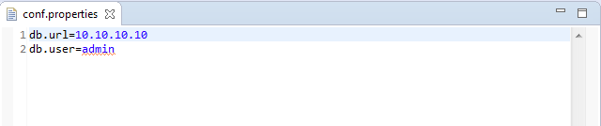
Static configuration
Static application configuration should be placed in properties files instead of hardcoding configuration values in application code.
Properties file can be read be application manually or with Spring usage
https://docs.oracle.com/javase/tutorial/essential/environment/properties.html
Notes:
ATS Application Programming: Java Programming
Brown Bag: XML
© Accenture 2005 All Rights Reserved
Course Code #Z16325

Slide 8
Activity
1. Create FlowerShop application package structure
2. Create entities, DTOs stubs (no attributes) that should be in application
3. Create business and access services interfaces with needed methods (no implementation required)

Slide 9
Questions
???
Notes:
ATS Application Programming: Java Programming
Brown Bag: XML
© Accenture 2005 All Rights Reserved
Course Code #Z16325

